Slide 1
Machine Learning 101
Doug Cha
©2018
http://github.com/dougfoo/machineLearning/
45min edition

Slide 2
Disclamers / Warning !
Written by a non AI/ML expert nor Data Scientist (but I’ve coded a lot of ML stuff)
Consider this content ~70% technically correct due to generalizations to simplify topics
References are added wherever possible – do your own research and form your own conclusions!
General Agenda:
What is DS, AI, ML etc ?
History and Evolution
Taxonomy of Major Types
Dive into Prediciton / Linear Regression
Extend to Logistic Regression
Neural Networks
Survey of Technology Offerings

Slide 3
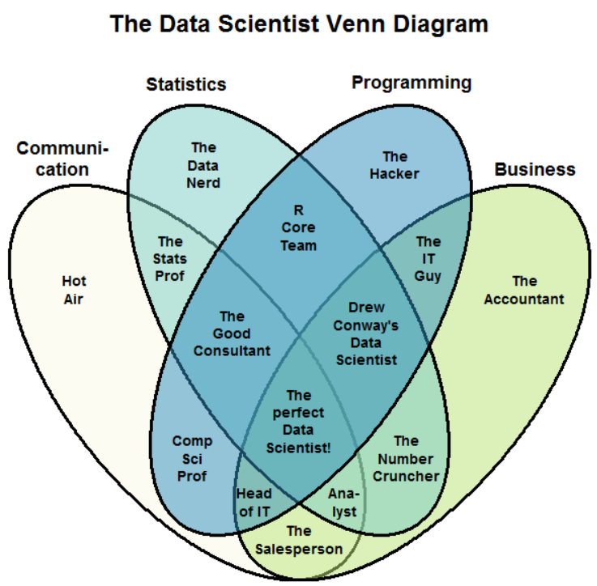
What is Data Science ?
https://www.kdnuggets.com/2016/10/battle-data-science-venn-diagrams.html

Slide 4
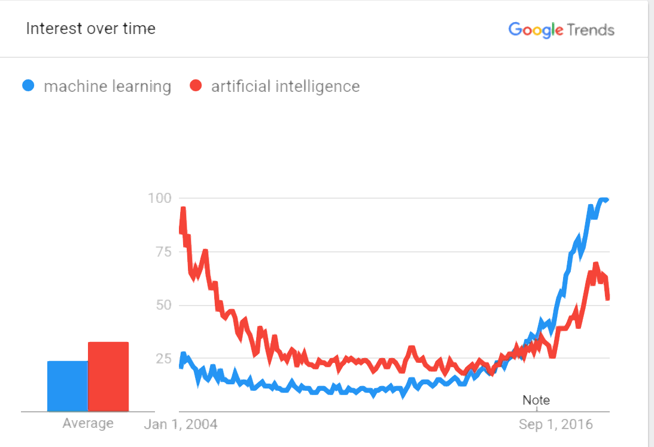
History and Evolution of AI/ML
Cleanup – what is bot left?
1943 - Alan Turing (Imitation Game) & John Von Neumman - fathers of modern computing
1956 - AI conference “Minksy/McCarthy” — focus on top-down rules (golden years 56-74)
1970 - Minksy “ in 3-8 yrs we will have a machine w/ the general intelligence of an average human being” <- bad claims all around
1973 - “AI Winter” (1974-1980)
1980’s - “Expert Systems boom” - DEC RI ($40m annual saving success)
1986 – Hinton Backprop
1987 (AI winter #2 - 1987-1993)
1997 - Deep blue (beat kasparov) ? (Brute force + heuristics), kasparov big on AI now
1999 - GPU invented (for games)
2007 - CUDA - GPU for non-games (finance/statistics)
2010 - First GPU for NN/Deep Learning - Goodfellow ch12.2
2010 SciKit initial release
2011 - IBM Watson Jeopardy .
– h20 & alteryx foundedt
2012 – DataRobot founded
2015 MSFT Azure ML
2016 PyTorch released
2017 - TensorFloww 1.0
2018 AWS Sagemaker
2045 - Kurtweil Prediction!
https://trends.google.com/trends/explore?date=all&q=machine%20learning,artificial%20intelligence
http://www.bbc.co.uk/timelines/zq376fr - “15 moments in story of AI”
http://en.wikipedia.org/wiki/History_of_artificial_intelligence
http://en.wikipedia.org/wiki/Infinite_monkey_theorem - Infinite Monkey Theorem

Slide 5
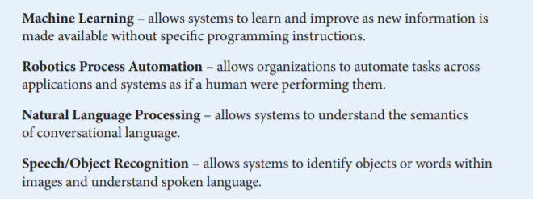
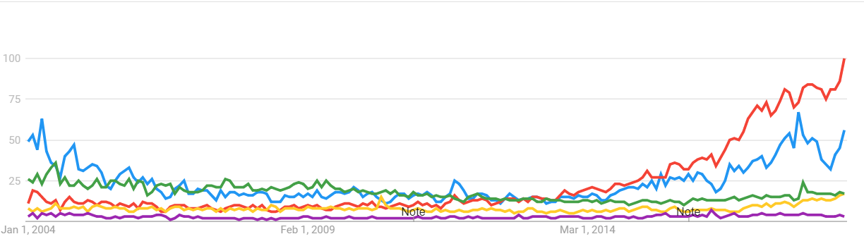
What is Artificial Intelligence ?
Google Trends 2004-Present AI vs ML vs NLP vs RPA vs Image Recognition
https://www.aba.com/Tools/Function/Technology/Documents/understanding-artificial-intelligence.pdf

Slide 6
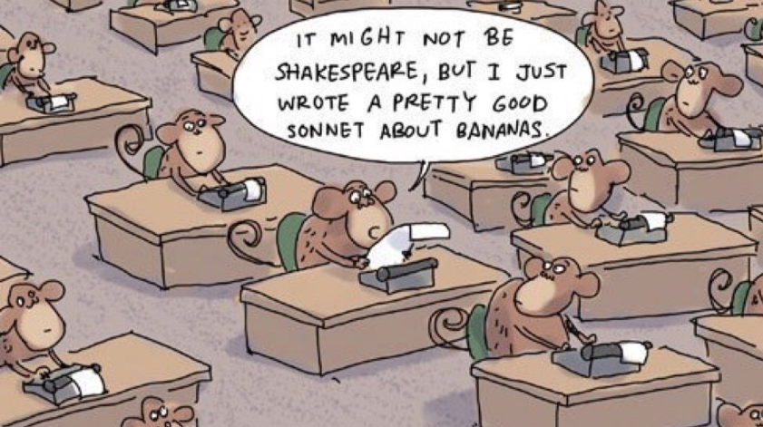
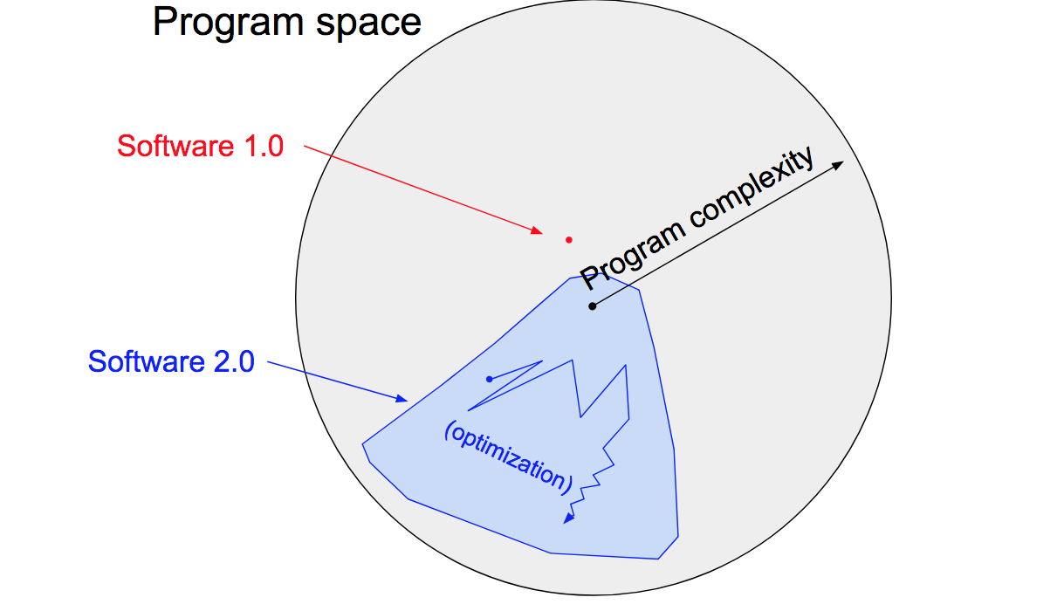
What is Machine Learning
Software Today (1.0):
Transformed to (2.0):
Input
Output
Machine
Output
Machine
Rules
Rules
Input
https://machinelearningmastery.com/basic-concepts-in-machine-learning/
https://medium.com/@karpathy/software-2-0-a64152b37c35 - A.Karpathy – Tesla Director of AI

Slide 7
Machine Learning Logical Example
WIP – too much text
Housing price "predictor" example:
- Inputs: sqft, br, bath, landsize, last price, last date, school rating, crime rating, inflation rate
- Output: Price Prediction !
Software 1.0: Human codes:
- Program of if/else conditional rules:
Answer = function housePrice(sqft, br, bath, land, lastp, lastdt, school, crime, inflation):
if (exists salesHistory) Then BasePrice = LastPrice* inflationRate
if (remodeled < 10yr) BasePrice*=1.10 … etc etc
- Or Modeled:
Answer = BasePrice*InflRate*µ + SqFt*α + #Br*β - CrimeRate*Ω + SchoolRating^2*π ,,,
Software 2.0: Machine codes:
- Data: (Price, sqft, br, bath, landsize, last price, last date, school rating, crime rating, inflation rate)
Answer "features"
- The Machine solves for the best the "rules" statistically

Slide 8
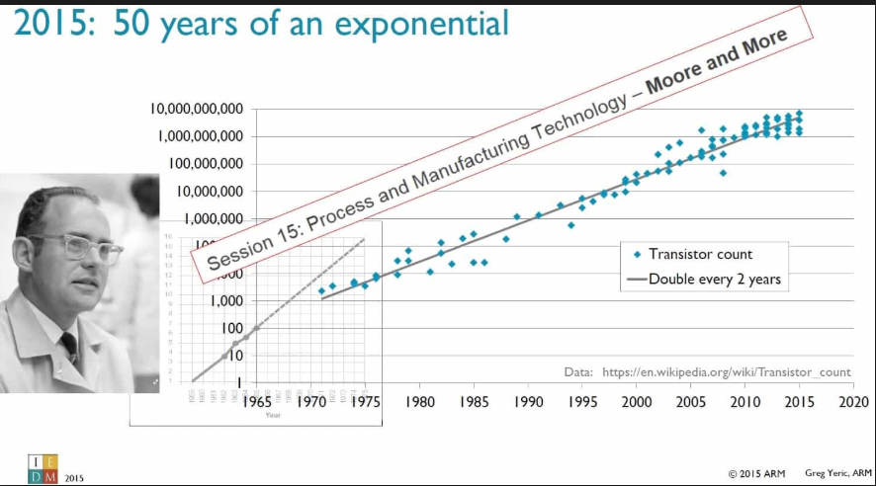
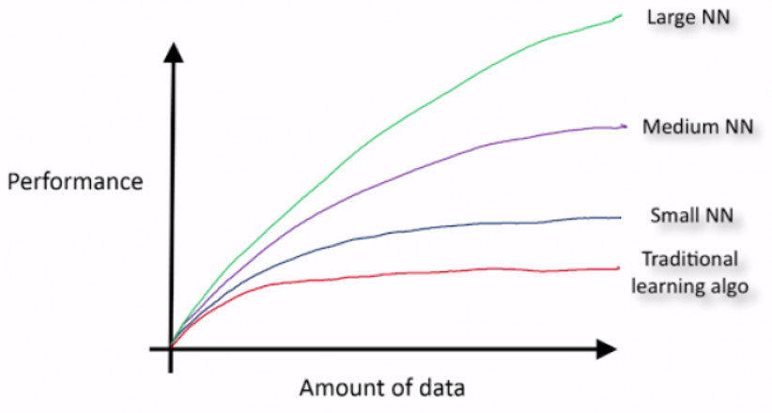
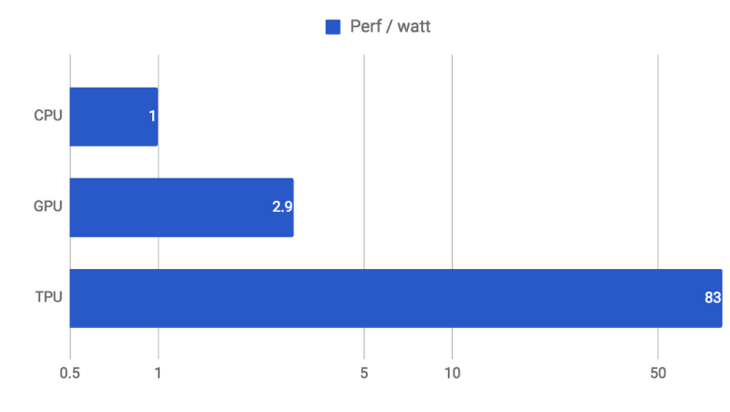
Why is ML so Hot ?
Hardware Leaps
Big Data (unreasonable effectiveness?)
More complex models need more data
Research (somewhat)
https://static.googleusercontent.com/media/research.google.com/en//pubs/archive/35179.pdf
https://cloud.google.com/blog/products/gcp/an-in-depth-look-at-googles-first-tensor-processing-unit-tpu
https://www.kdnuggets.com/2015/06/machine-learning-more-data-better-algorithms.html

Slide 9
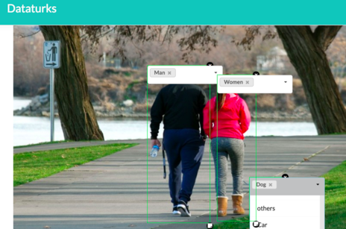
Machine Learning Types
Labelled == Supervised
Unlabelled == Unsupervised
Amazon Customer ID | Makeup Purchases | Hardware Purchases | Book Purchases
1 | $21 | $355 | $185
2 | $375 | $12 | $188
3 | $140 | $100 | $100
4 | $8500 | $7200 | $5000
5 | $7500 | $100 | $4500
Some is manually tagged
(someone is drawing boxes around millions of photos... )
Tabular data example:
1
$
$$$
5
M
4
F
3
Amazon.com M/F Label ?? | Makeup Purchases | Hardware Purchases | Book Purchases
M | $21 | $355 | $185
F | $375 | $12 | $188
2

Slide 10
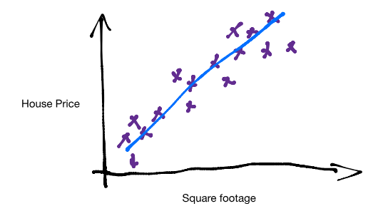
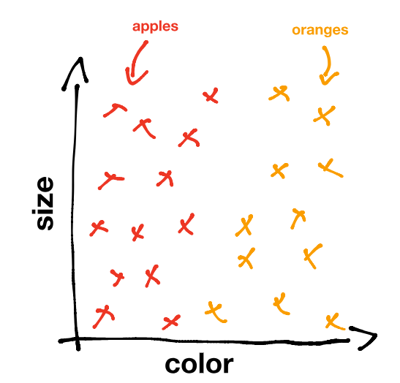
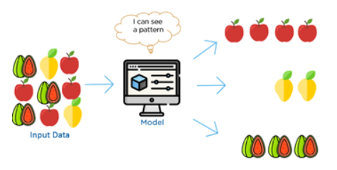
Machine Learning Types
Prediction
Labelled Classification
Un-Labelled / Clustering (patterns in data)
https://www.kdnuggets.com/2017/05/machine-learning-crash-course-part-1.html
https://www.youtube.com/watch?time_continue=6&v=G7fPB4OHkys

Slide 11
Machine Learning Workflow
Data Sourcing
ETL / ELT
Normalize
Data Store
RDBMS
KDB
Feature Engineer
Cleanse
Data Warehouse
Hadoop Data Lake
Load
Model Selection
Encoding
Normalize
L-Regress
SVM
NN, CNN, RNN
Train
Param tuning
Cross Validate
Deploy
Monitor
Refine and iterate
Refine and iterate
Evaluate Results
Selection
Release
Typical Workflow
II. Refine Features & Model
I. Load/Cleanup Data
Durations ?
12 month project
9 months+ – 80%
2-3 months+ – 15%
1-2 months+ – 5%
https://www.kaggle.com/willkoehrsen/start-here-a-gentle-introduction

Slide 12
Training a Simple Linear Model - example (0)
More Simplification Needed
Example:
How to build a house price predictor?
Using inputs (features)…
X₁ – SqFt Building
X₂ – SqFt Land
X₃ – # Bedrooms
X₄ – Local School Rating
Try a Linear price model:
p(X) = A*X₁ (SqFt Building) + B*X₂ (SqFt Land) + C*X₃ (# Bedrooms) + D*X₄ (School Rating)
Where A,B,C,D are some “weights” on each input
General form:
p(X) = W₀ + W₁*X₁ + W₂*X₂ + W₃*X₃ + ….
How do we set Weights?
(Remember the Monkeys writing Shakepeare? -- we can keep guessing until we find optimal one ?)
Or – use real examples to learn “weights” W_{n} – ie, based on actual data !!
This process is called Training the model !!!
Eventually solve the optimization problem, p(X) = 155 + 0.22*X₁ + -0.08*X₂ + 0.87*X₃ + ….

Slide 13
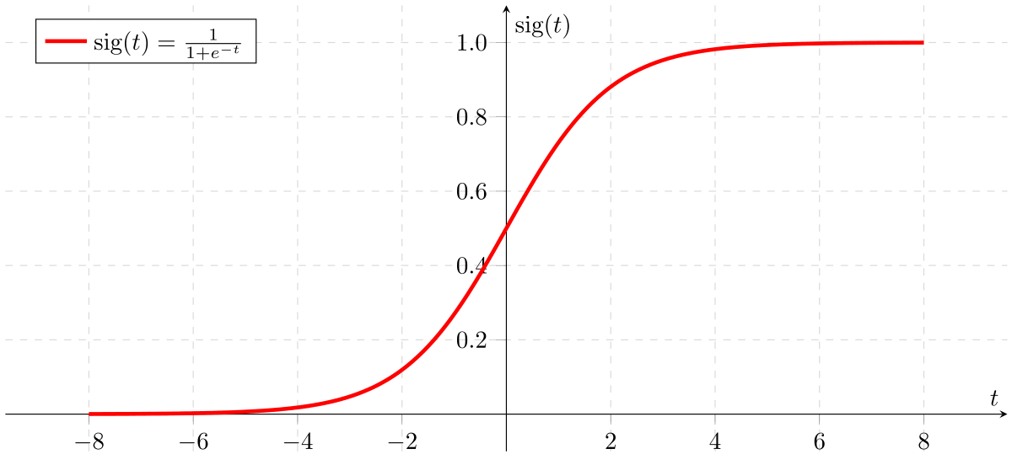
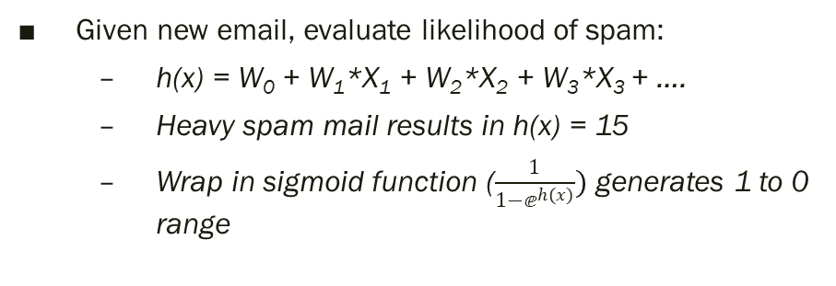
Logistic Regression – Classification
Using X_{n} - feature inputs, calculate a probability of Y or N (1 or 0)
Example E-mail Spam Detector – 4 feature “scores” generates a +/- result
X₁“Urgent”
W₁
X₂“Help”
Logistic F
Sigmoid, Relu, TanH Function
Spam?
1 or 0 (Y/N)
W₂
X₃“Audit”
W₃
W₄
X₄“Hello”
…
…
Training model sets W₁₋₄ values -1 to 1, eg:
“Urgent” – likely spam, W₁ ~ +0.9
“Help” – maybe spam, W₂ ~ +0.4
“Audit” – not likely, W₃ ~ -0.9
“Hello” – not sure, W₄ ~ +0.1
Given new email, evaluate likelihood of spam:
h(x) = W₀ + W₁*X₁ + W₂*X₂ + W₃*X₃ + ….
Heavy spam mail results in h(x) = 15
Wrap in sigmoid function ($\frac{1}{1−ⅇ^{h(x)}})$ generates 1 to 0 range
(4 features * 1,000 examples = 4,000 partial derivatives to calculate. Typical email may have ~500 words/features. Full corpus 50k)

Slide 14
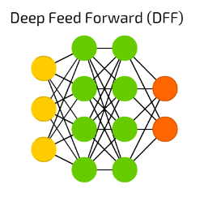
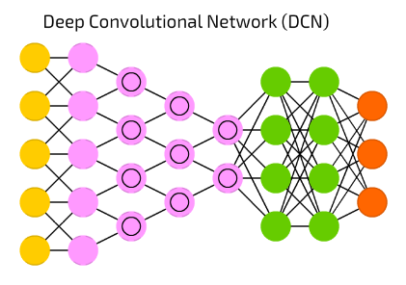
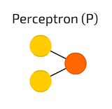
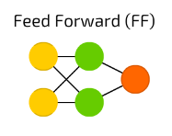
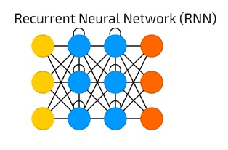
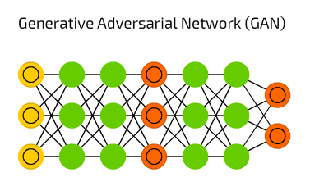
Multi-Layers = Neural Network
Looks like
Logistic Regression??
https://towardsdatascience.com/the-mostly-complete-chart-of-neural-networks-explained-3fb6f2367464

Slide 15
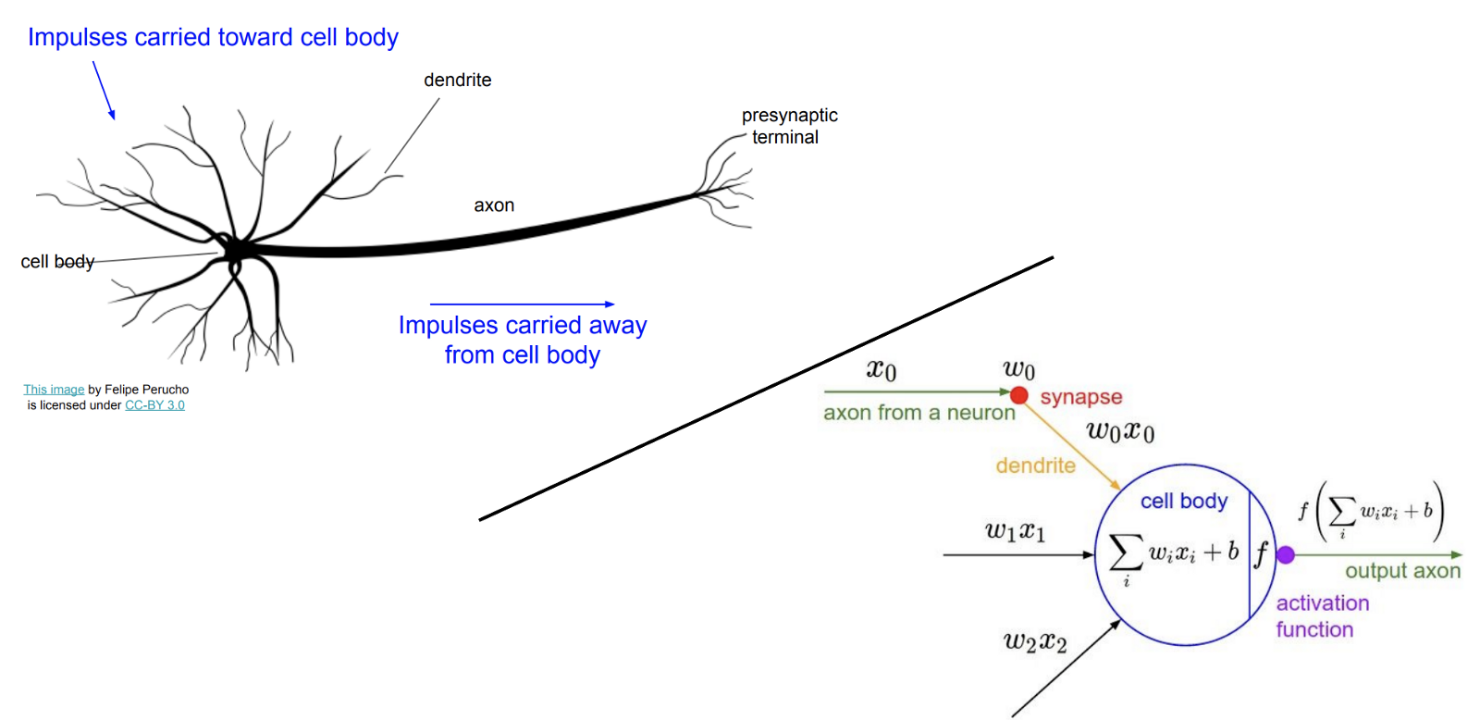
Neural Networks & the Brain
Walk thru talk better
The Computer and the Brain – John Von Neumann 1958
First concept of an Artificial Neural Network (Human Brain) was 1943 – Pitts & McCullough
Biology doesn’t really match, but it sounds great “Deep Learning” (hype)
Interesting facts:
Worm C Elegans – 300 Neurons
Fruit Fly – 135k Neurons
Human – 80B-100B Neurons
Modelling AI / ANN this way is
not going to work… !!
https://en.wikipedia.org/wiki/Artificial_neural_network
http://cs231n.stanford.edu/slides/2017/cs231n_2017_lecture4.pdf

Slide 16
Challenges to think about
Feature Growth – (Imagine 1 for every word in the dictionary ???)
Slow to train
Hard to determine valuable features vs junk
("A, And, Is, Or, …. ")
Models work best with lots of data
Where do we get all this labelled data ??
Non-Numeric Features
These models only work with #'s (output being 0-1.0)
How to encode Trade Type = “Swap, Bond, Future” into digits ?
How to normalize across numbers of various ranges (Notional $100m’s vs Gender M/F)
X₁“Urgent”
W₁
X₂“Help”
Spam?
1 or 0 (Y/N)
W₂
X₃“Audit”
W₃
W₄
X₄“Hello”
…
* 100,000 words ?

Slide 17
Challenges to think about (2)
Which model to use – there are so many ….
Dozens of clustering methods (SVM, K-Means, K-NN)
Tree algorthms (Decision Tree, Random Forests, etc)
Neural Nets (CNN, RNN, GAN, etc)
Ensemble methods (XG Boost)
More being invented every year !
Training takes time (can take days/weeks on hundreds of CPU to train an AI)
Game AI Dota2 (open.ai 2017) Months w/ 256 GPUs and 128,000 CPU cores !!
Alpha Go (Google 2015) – 40 days w/ 176 GPU
Alpha Go Zero (2017) – 3 days w/ just 4 TPU !!
https://blog.openai.com/openai-five/
https://en.wikipedia.org/wiki/AlphaGo
https://deepmind.com/blog/alphago-zero-learning-scratch/

Slide 18
State of AI/ML – Platform Showdown
Big Data &
Database Vendors
API/Analytic Toolkits
Full Stack Vendors
Cloud
Providers
Scikit Learn
TensorFlow
MXNET
PyTorch
Apache Spark & Hadoop
KDB
Oracle
Alteryx
H2o
Tableau
Google GCP
Amazon AWS
MSFT Azure
Oracle
Data Robot
Note on the danger of SkyNet & “The Singularity” (Ray Kurtzweil & Von Neumann)

Slide 19
Machine Learning Workflow
Typical Workflow
Data Sourcing
Data Store
Feature Engineer
Model Selection
Train
Deploy
II. Refine Features & Model
I. Load/Cleanup Data
Durations
12 month project
9 months+ – 80%
2-3 months+ – 15%
1-2 months+ – 5%
Platform Strengths
Big Data Vendors
Full Stack Vendors
Cloud Vendors
API Vendors

Slide 20
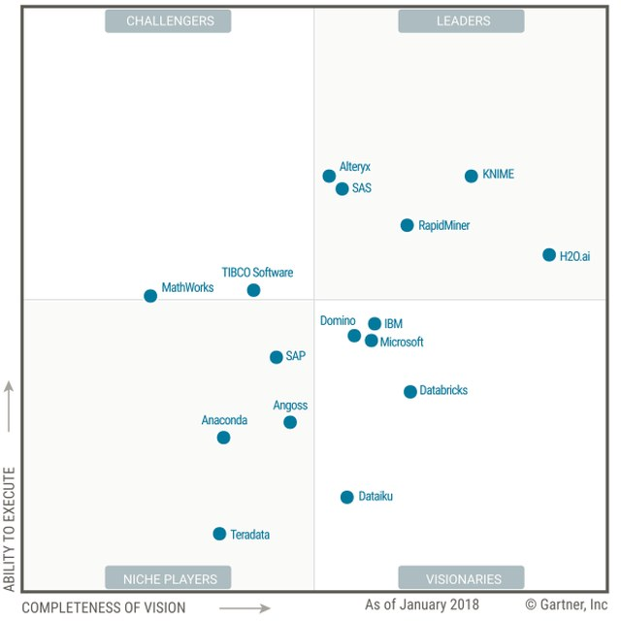
Full Stack Vendors
Summary of Gartner Magic Quadrant Analysis
“Full Stack Vendors” offer a E2E solution –
Some Data Loading ETL tools
Some Data Storage
Feature Selection Tools
Strong DS Test Env & Auto-ML
Deployment tools
Visualization/Dashboards
Where is Data Robot??
https://www.gartner.com/doc/3860063/magic-quadrant-data-science-machinelearning

Slide 21
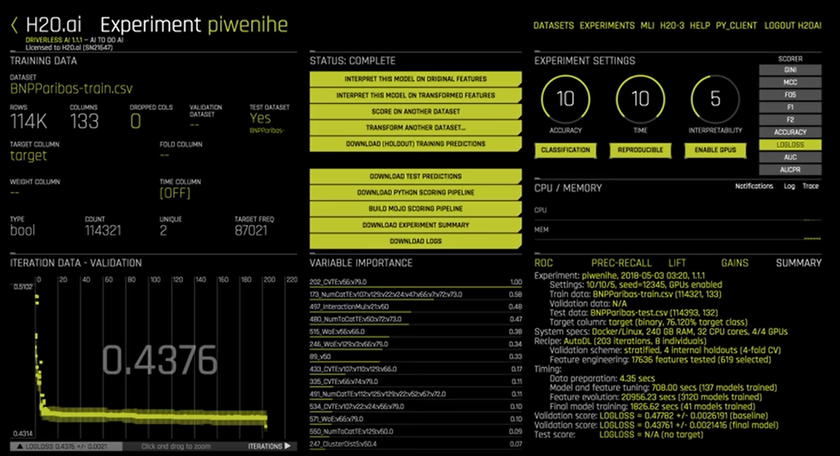
Full Stack Vendors (2)
H20 – “Driverless AI” – AutoML
Give a dataset (114k rows, 133 columns) – does all the work for you !
Auto-tune !
200 Iterations
117k features tested
3k models tested
Best results found
automatically (6hr)
https://www.gartner.com/doc/3860063/magic-quadrant-data-science-machinelearning

Slide 22
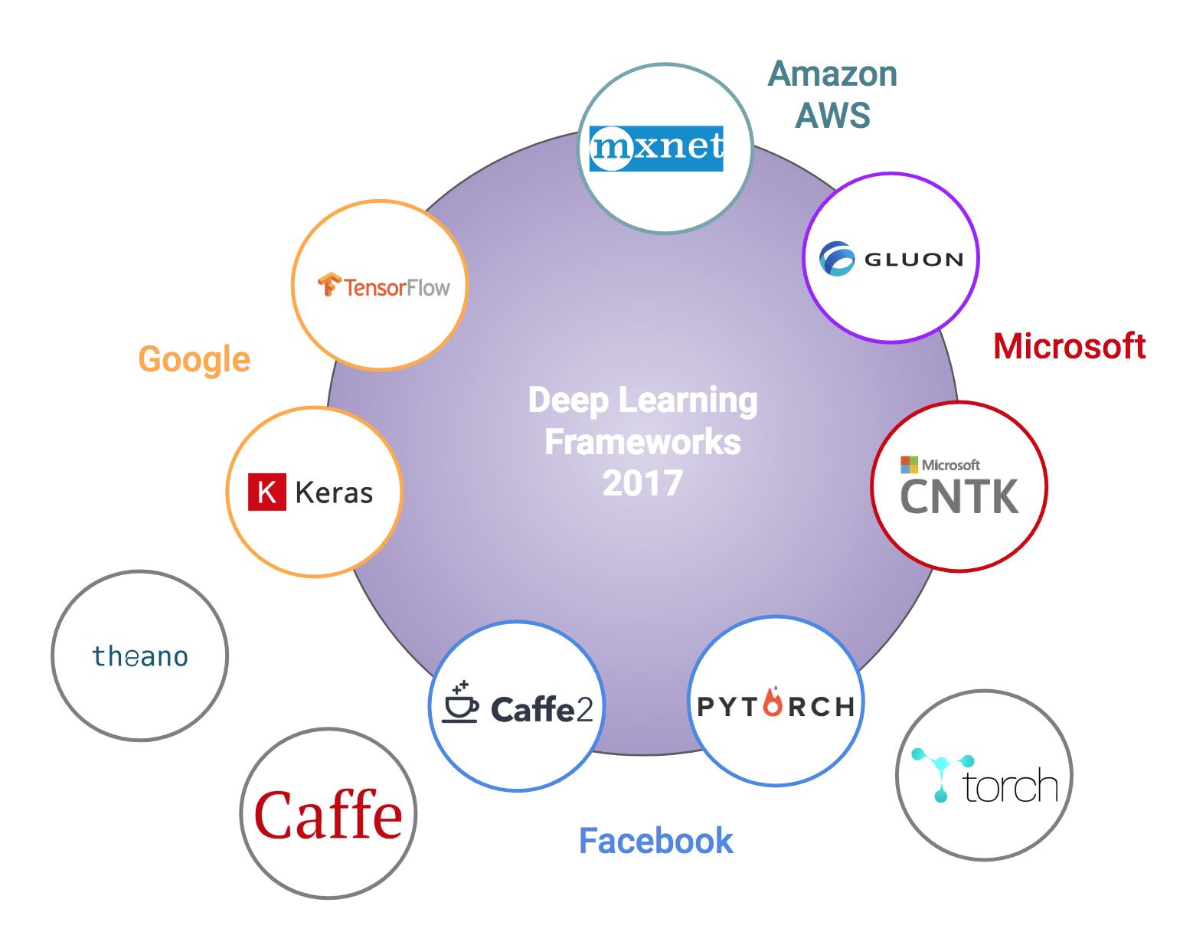
API/Analytic Toolkits
API and Analytic Libraries
Low level Libraries
All do the same thing (diff GPU/OS support)
Good for highly technical teams just needing an API library
They are all similar.. And seem to be converging (TensorFlow, PyTorch, Keras are winning ?)..
https://towardsdatascience.com/battle-of-the-deep-learning-frameworks-part-i-cff0e3841750

Slide 23
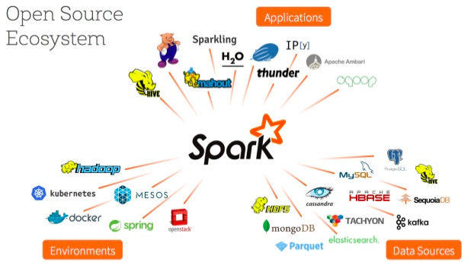
Big Data – Apache Spark/Hadoop
Apache Spark & Hadoop
KDB
Oracle
IBM
Bring ML to the data
(Data being the hardest part ?)
https://www.slideshare.net/databricks/spark-mllib-from-quick-start-to-scikitlearn

Slide 24
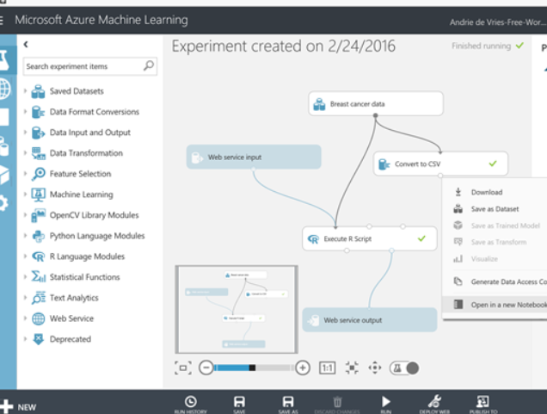
Cloud Offerings
Amazon AWS
Azure ML Studio
Google GCP & Tensorflow
Oracle Cloud Platform (GCP)
Sony Cloud
Features:
CPU/GPU/TPU on demand
Some have GUI’s
Good Data backend integration
Strong deployment tools

Slide 25
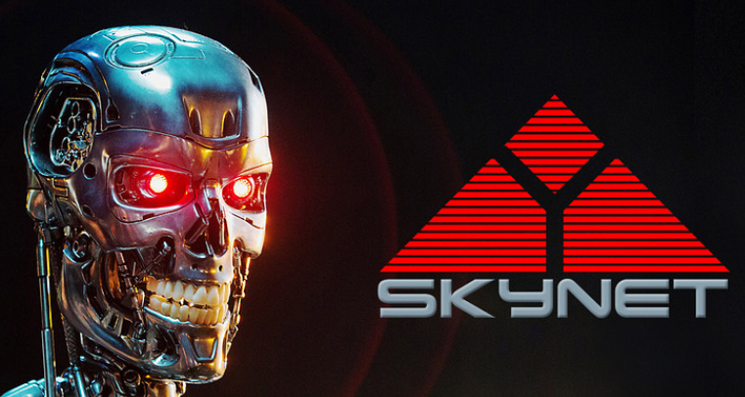
Final Words
“Stephen Hawking warns artificial intelligence could end mankind ...”
“Beware the singularity, says Skype founder | Stuff.co.nz”
The "Father of Artificial Intelligence" Says Singularity Is 30 Years Away ...
The Singularity..
Theory/Logic
If we can train a machine to be “smarter” than us (the creators) – “the singularity”
Then the machine can train another machine to be smarter than itself
Recursively – it can evolve into a super-intelligence
What this sometime for fun: https://www.youtube.com/watch?v=ye5C-zlCAyM&t=211s
In Practice.. we are nowhere near this for “Artificial General Intelligence” – all applications so far are “Narrow Intelligence”… Kurtzweil thought we are < 30yr away (See: AI Winter)
https://en.wikipedia.org/wiki/Technological_singularity
“Singularity” term comes from Ray Kurtzweil, who says he came up with this from reading works by John Von Neumann
https://www.technologyreview.com/s/608911/is-ai-riding-a-one-trick-pony/

Slide 26
References
History of ML
http://www.psych.utoronto.ca/users/reingold/courses/ai/cache/neural4.html
https://cs.stanford.edu/people/eroberts/courses/soco/projects/neural-networks/History/history1.html
https://www.import.io/post/history-of-deep-learning/
https://en.wikipedia.org/wik/Timeline_of_machine_learning
Singularity
Ray Kurzweil – Singularity - https://en.wikipedia.org/wiki/The_Singularity_Is_Near
John Von Neumann - https://en.wikipedia.org/wiki/The_Computer_and_the_Brain
Hardware
TPU diagram (scalar, vector, matrix) and perf chart: https://cloud.google.com/blog/big-data/2017/05/an-in-depth-look-at-googles-first-tensor-processing-unit-tpu#closeImag
Other
Kaggle – Boosting 70% wins (article: https://medium.com/syncedreview/tree-boosting-with-xgboost-why-does-xgboost-win-every-machine-learning-competition-ca8034c0b283)

Slide 27
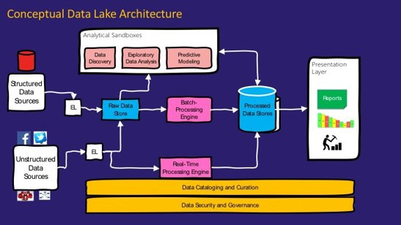
Appendix
https://medium.com/@rpradeepmenon/demystifying-data-lake-architecture-30cf4ac8aa07​
https://www.jamesserra.com/archive/2015/04/what-is-a-data-lake/

Slide 28
How it really works - Linear Regression example (1)
100’s $
Linear price model:
h(x) = W₀ + W₁*SqM + W₂*Loc + W₃*BR + …
General form:
h(x) = W₀ + W₁*X₁ + W₂*X₂ + W₃*X₃ + ….
Use X^{n} samples to learn “weights” W_{n}
10 SqM
Simplified Model example using just 1 variable/feature.
h(x) = W₀ + W₁*SqM
ie, y = mx+ b (solve for the regression line)
Solve for W₀,W₁ given x samples {5,10,15,20]; y labels=[3,4,3,5]
Algorithm:
Choose random W₀,W₁
Calculate Error (MSE - Mean Square Error)
Adjust W to minimize MSE (Gradient Descent)
Iterate until minimum error
Adapted from Andrew Ng’s Machine Learning course: https://www.coursera.org/learn/machine-learning )

Slide 29
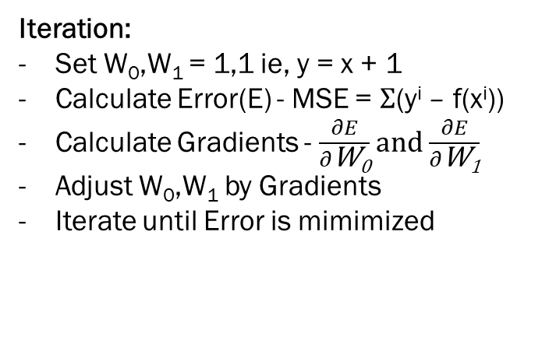
How it really works - Linear Regression example (2)
100’s $
x samples {5,10,15,20]; y labels=[3,4,3,5]
Algorithm:
Choose random W₀,W₁
Calculate Error (MSE - Mean Square Error)
Adjust W to minimize MSE (Gradient Descent)
Iterate until minimum error
10 SqM
Iteration:
Set W₀,W₁ = 1,1 ie, y = x + 1
Calculate Error(E) - MSE = $Σ$(y^{i} – f(x^{i}))
Calculate Gradients - $\frac{∂E}{∂\text{W}\text{0}}$ and $\frac{∂E}{∂\text{W}\text{1}}$
Adjust W₀,W₁ by Gradients
Iterate until Error is mimimized

